Slide 1
Cellular Soldering
Carl, David, & Seth

Slide 2
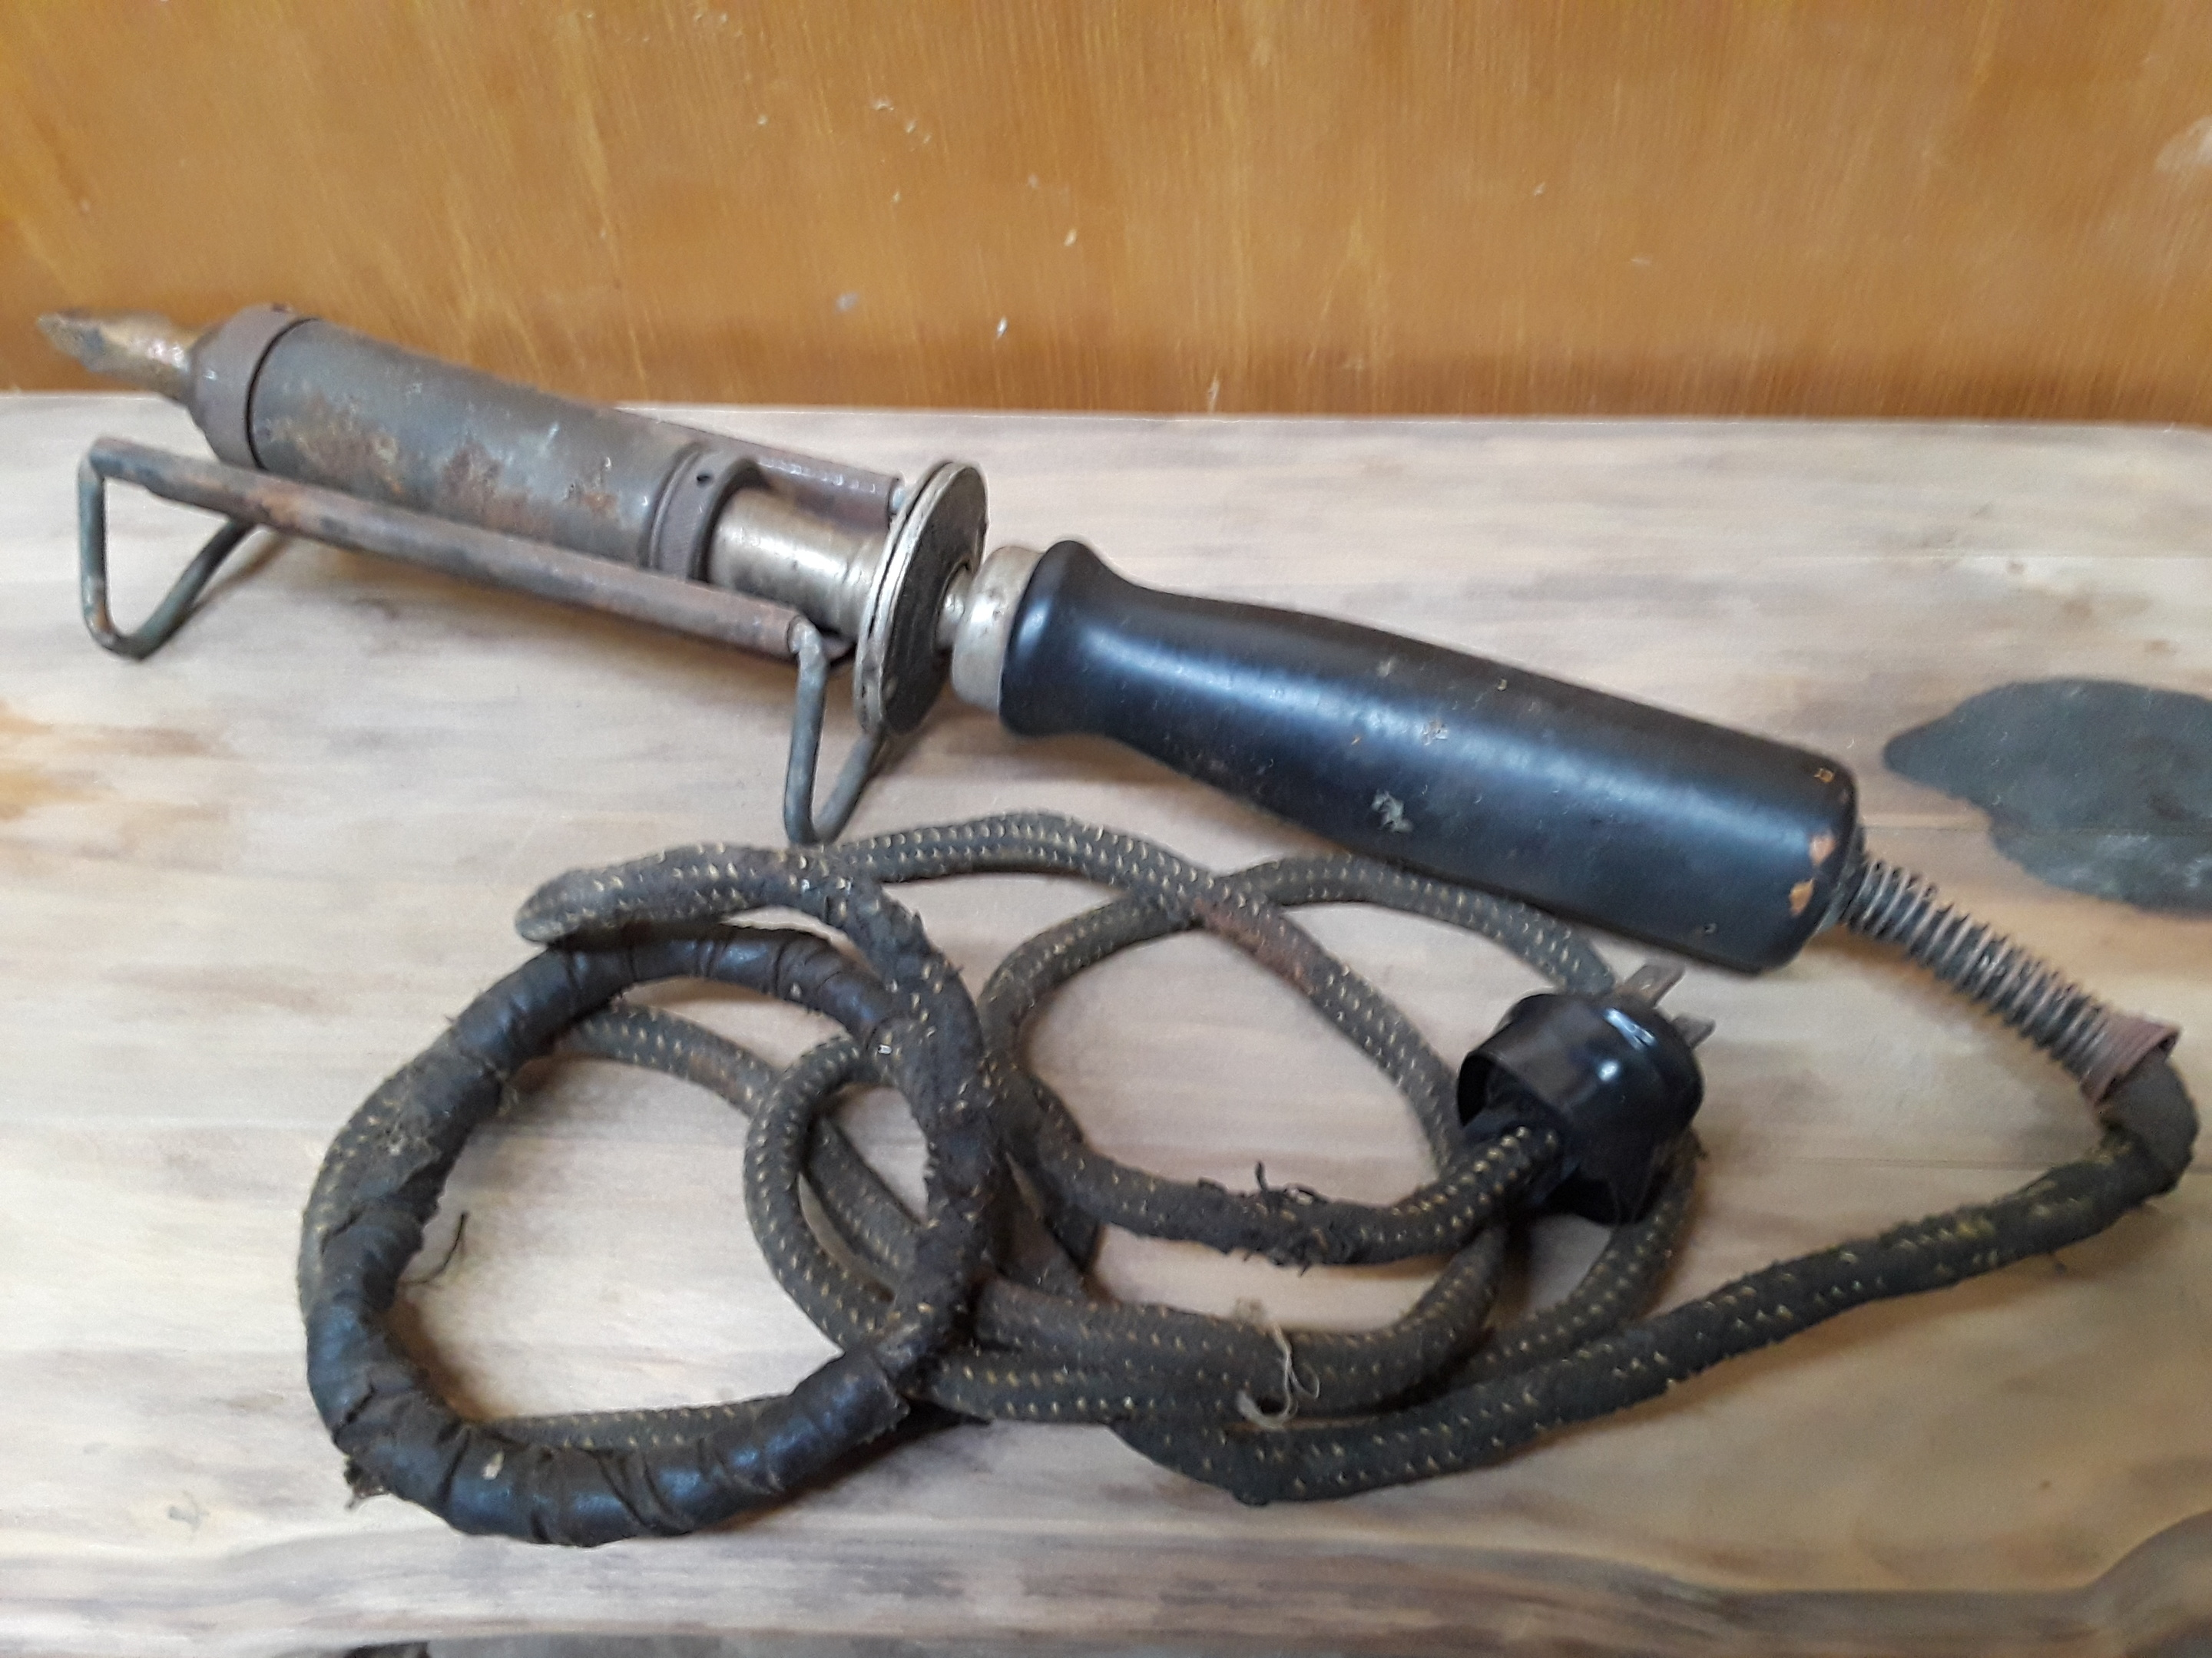

Richard Snyder &
August Tinnerholm
In 1896, the American Electrical Heater Company was granted a patent for the invention of the “electric heating apparatus,” or what's better known as the modern electric soldering iron.
Notes:
In 1896, the American Electrical Heater Company was granted a patent for the invention of the “electric heating apparatus,” or what's better known as the modern electric soldering iron.
Ernst Sachs in German claimed that he was the first to invent such a device in 1921

Slide 3
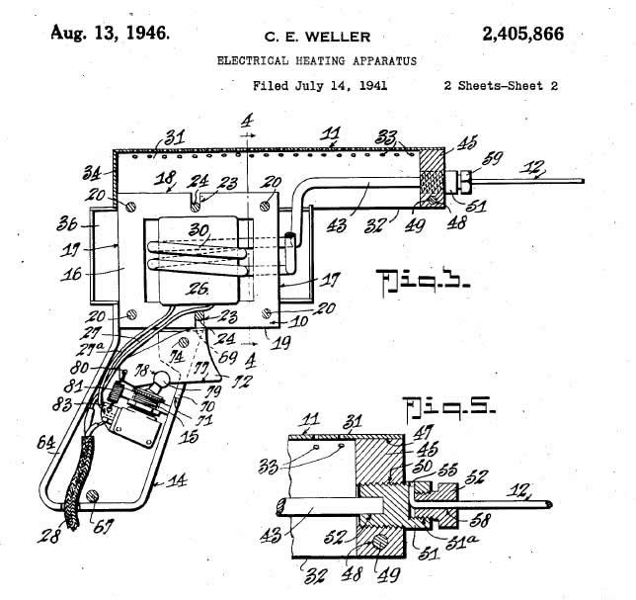

Carl Weller
Was tired of waiting…
Carl’s soldering iron took too long to get to temperature, so in 1941 he invented the soldering gun.
Notes:
“Carl Weller had to use a soldering iron as a part of his everyday routine, but he felt that the soldering iron did not heat up fast enough. In 1941, using his knowledge of electronics, he created a new way to heat the tip of the soldering iron, thus inventing the soldering gun.”

Slide 4
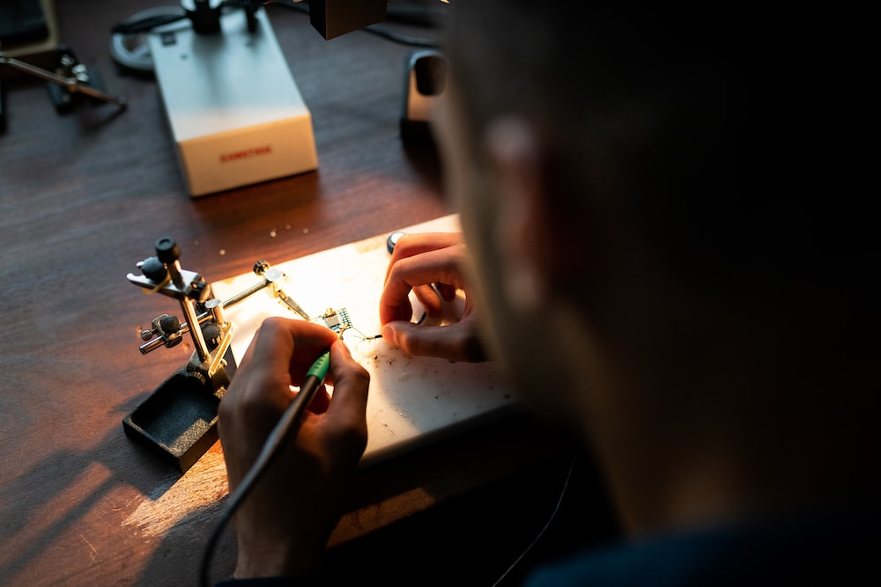
Traditional Soldering
Cellular Soldering
Wired
Solitary
Offline
Wireless
Collaborative
Web Scale
IronOS
Cellular
Notehub
Online Dashboard

Slide 5
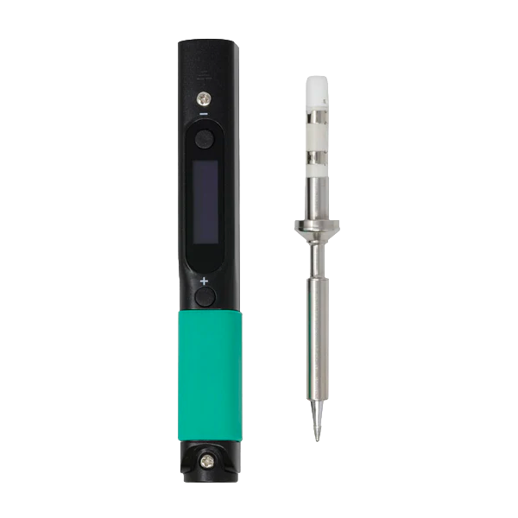


Pinecil + Blues = Cellular Soldering

